Slide 1








Boosting Algorithms in Machine Learning
prepared by Madhusudhanan

Slide 2




Boosting
Introduction to Boosting Algorithms
Boosting is an effective ensemble method in machine learning that enhances the accuracy of prediction models. It works by sequentially combining several weak learners to create a single, strong learner. This approach reduces errors by paying extra attention to the data points that were previously misclassified.
Boosting = Many simple models + Learn from past mistakes = Accurate prediction
Imagine you're guessing the price of a house:
1st guess: ₹40L (way off)
You realize you're off by ₹10L, so you learn from that mistake.
2nd guess adds ₹6L correction → ₹46L
Still off, so 3rd guess adds ₹3L → ₹49L
Keep refining...
Eventually, you're very close to the actual price.

Slide 3

Define boosting algorithms and their significance in improving prediction accuracy through ensemble methods that combine multiple weak learners.
Objectives
Explain how AdaBoost, XGBoost, and LightGBM function, highlighting their unique approaches to handling data and optimizing performance.
Understanding Boosting Algorithms in AI
Discuss the advantages and practical applications of each algorithm, showcasing their effectiveness in various machine learning tasks across industries.

Slide 4




Understanding AdaBoost Algorithm
Boosting = General concept of combining weak learners sequentially
AdaBoost = Specific method that adaptively adjusts weights to focus on hard cases
AdaBoost, short for Adaptive Boosting, is one of the earliest and most popular boosting algorithms. It combines multiple weak learners (usually shallow decision trees called decision stumps) to create a strong learner. It's called adaptive because it adjusts the weights of data points to focus on the ones most often mispredicted.

Slide 5
AdaBoost Algorithm Simple Diagram
Fruit Data --> Weak Learner 1 (Color rule) --> Some mistakes
↓
Increase weight on mistakes
↓
Fruit Data --> Weak Learner 2 (Weight rule) --> Better predictions
↓
Combine Learners with weighted votes
↓
Final Prediction (Apple or Orange)

Slide 6





Understanding the XGBoost Algorithm
XGBoost Algorithm (Extreme Gradient Boosting) is a powerful, scalable, and efficient implementation of the gradient boosting framework. It builds an ensemble of decision trees sequentially, where each new tree aims to correct the errors (residuals) made by the previous trees. XGBoost enhances traditional gradient boosting by incorporating second-order derivative information (Hessian), regularization techniques to prevent overfitting, and system optimizations such as parallel processing and efficient memory usage, making it one of the fastest and most accurate machine learning algorithms for regression, classification, and ranking tasks.
Example : XGBoost builds many small trees step-by-step, each fixing errors of the previous ones, to accurately predict outcomes—fast and efficiently.

Slide 7
Understanding the LightGBM
LightGBM(Light Gradient Boosting Machine) is a fast and efficient machine learning algorithm that builds decision trees in a smart way to quickly learn from large amounts of data, making accurate predictions while using less memory and handling missing information automatically—perfect for beginners working with big datasets.
Example: LightGBM learns from fruit weights and their types (apple or orange). After training, it predicts the type of a new fruit based on its weight—fast and accurately, even with lots of data.

Slide 8
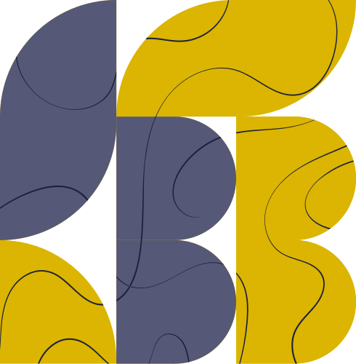


Advantages of Boosting Algorithms
Improved Accuracy
Versatility
Robustness to Overfitting
Boosting techniques combine multiple weak learners to create a strong predictive model, resulting in higher accuracy compared to single models.
These algorithms can be applied to various tasks, including classification and regression, making them versatile tools in machine learning.
Boosting helps reduce overfitting by focusing on misclassified instances, enabling models to generalize better on unseen data.

Slide 9
Comparison of Boosting Algorithms: AdaBoost vs XGBoost vs LightGBM
Algorithm | Speed | Accuracy | When to Use
AdaBoost | Slow | Good (simple data) | Simple or small datasets
XGBoost | Fast | Very good | Balanced speed & accuracy
LightGBM | Very fast | Very good | Huge datasets, faster training

Slide 10



Thank You for Attending!
Let's Connect and Collaborate
Address
1128 HIDDENRIDGE 2158, IRVING, TEXAS 75038
Phone Number
+1-972-946-6351
madhusudhanan.jayaram@gmail.com

